Slide 1
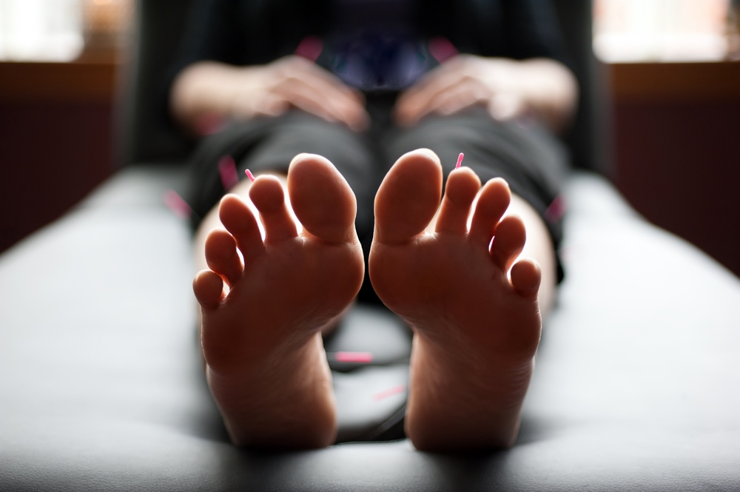
Acupuncture &
Medical Qigong Care
A Better Way
Dr. Shannon Freeman, D.Ac, DCEM – Indigenous Decent Practitioner
UNDERSTANDING A 2,500 YEAR OLD THERAPEUTIC MODALITY
PRESENTED TO LUMMI INDIAN HEALTH CLINIC
Notes:
Angela Decker, Licensed Medical Massage Pracitioner
Impingment Sx, TMJ, Chronic Pain Syndromes, Womens Health
Yvonne Newgard, Certified Cupping Therapist and Active member of the Fire department as an EMT.
Frozen Shoulder, Neck, Hip/SI joint pain, Fibromyalgia,, and Chronic Pain.

Slide 2
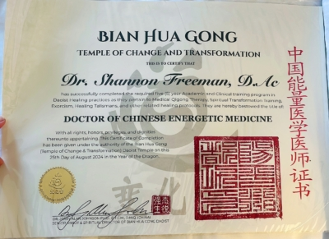
ABOUT ME & CLINIC
Solo practitioner: Dr. Shannon Freeman, Native (Turtle Mountain Band of Chippewa – Ojibwe/Cree/Métis)
35+ years in healthcare; integrates Acupuncture + Medical Qigong (retired CNA and MT)
Doctorate in Acupuncture and a
Doctorate in Chinese Energetic Medicine
Clinic: 1118 Finnegan Way, Suite 103, Fairhaven – peaceful bay views
Culturally respectful, whole-person care that complements conventional medicine

Slide 3

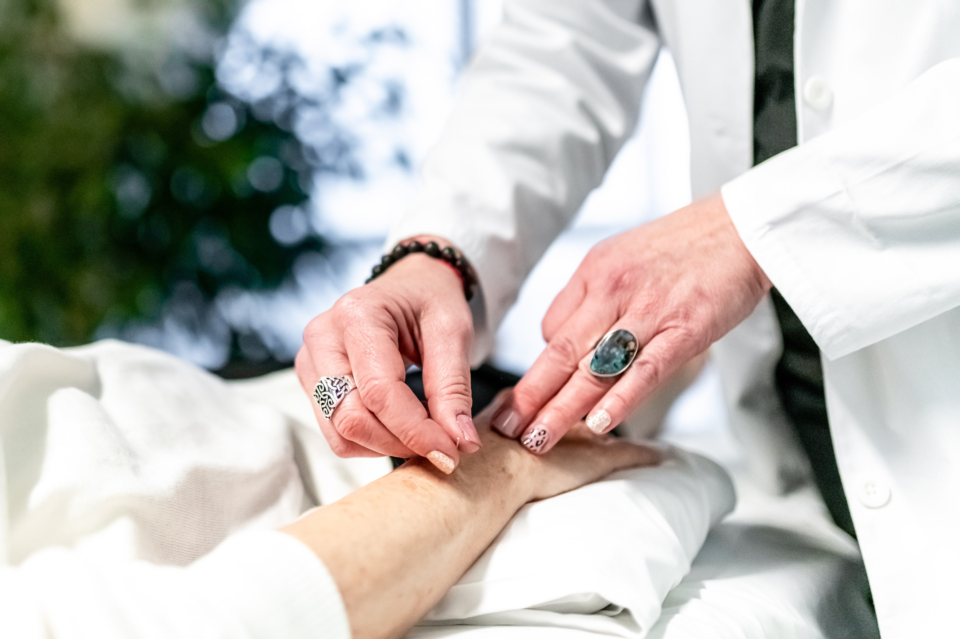
OUR APPROACH
We emphasize integrative, non-pharmacological care for pain, stress, addiction support, trauma, and wellness — without adding more medications.

Slide 4
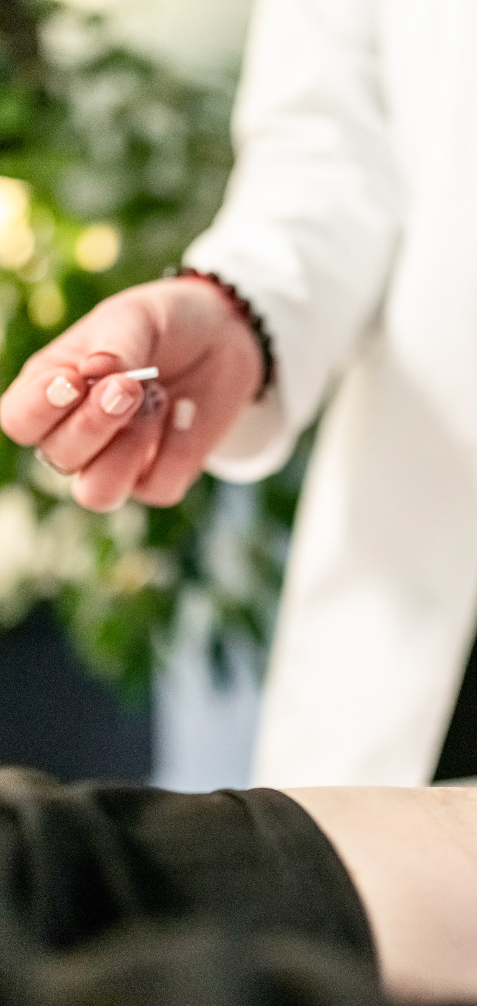
ACUPUNCTURE TREATMENT BASICS
95% painless
Extremely safe (FDA Class II medical tools)
All natural — no drugs or side effects
Most issues improve in 2–6 treatments
NIH & JAMA recognized for pain & nausea

Slide 5
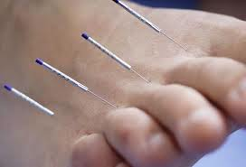
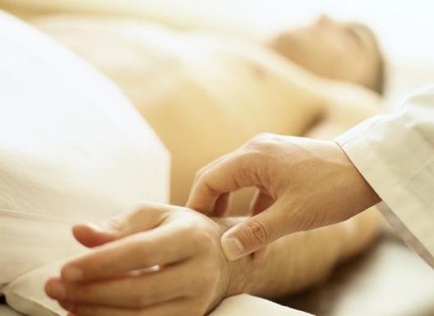
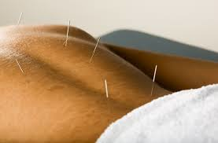
What a First Treatment is Like
Comprehensive intake + tongue/pulse diagnosis
Relaxing, personalized session (often starting face-up)
Needle retention 30 minutes + Medical Qigong as needed
Reports sent to referring provider, upon request

Slide 6
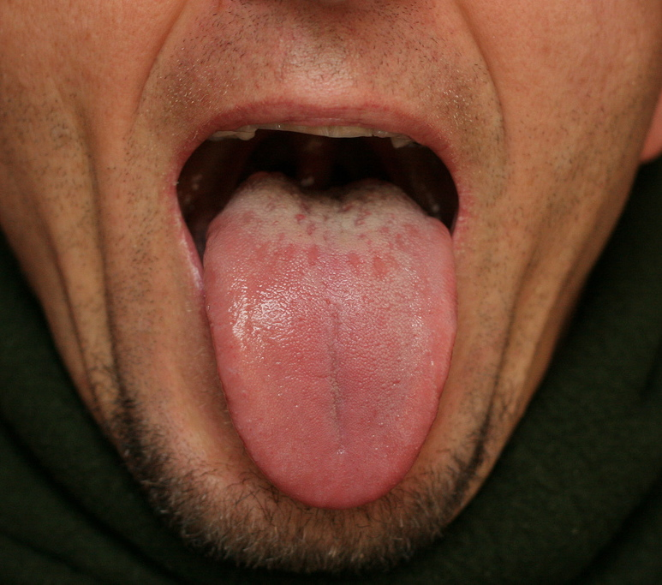
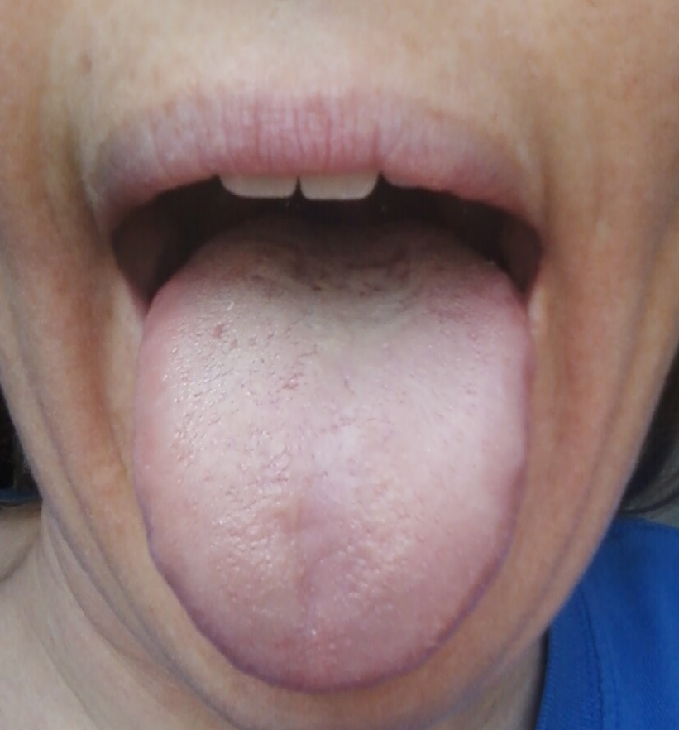
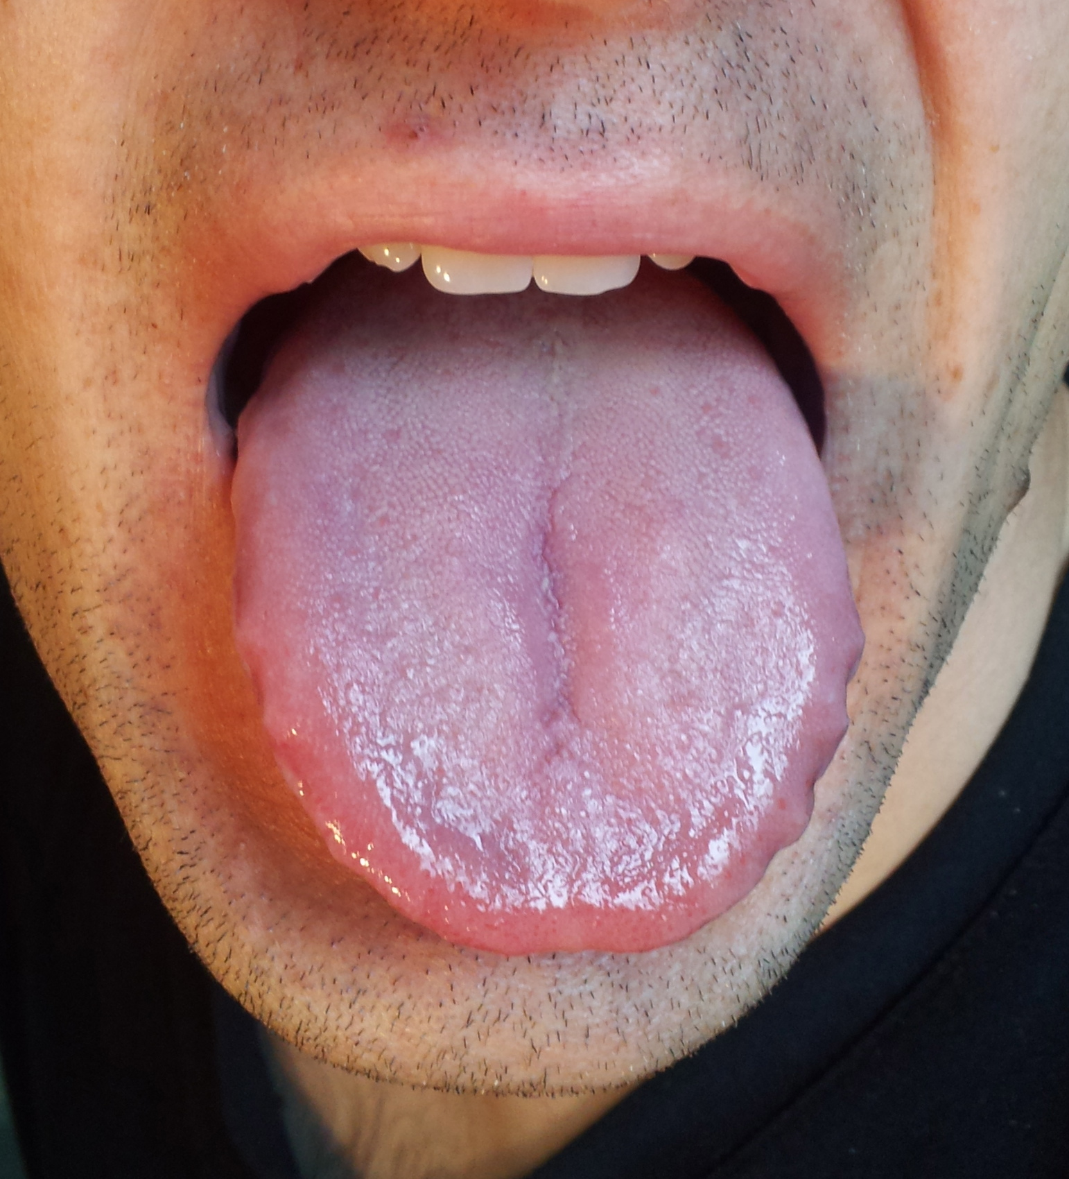
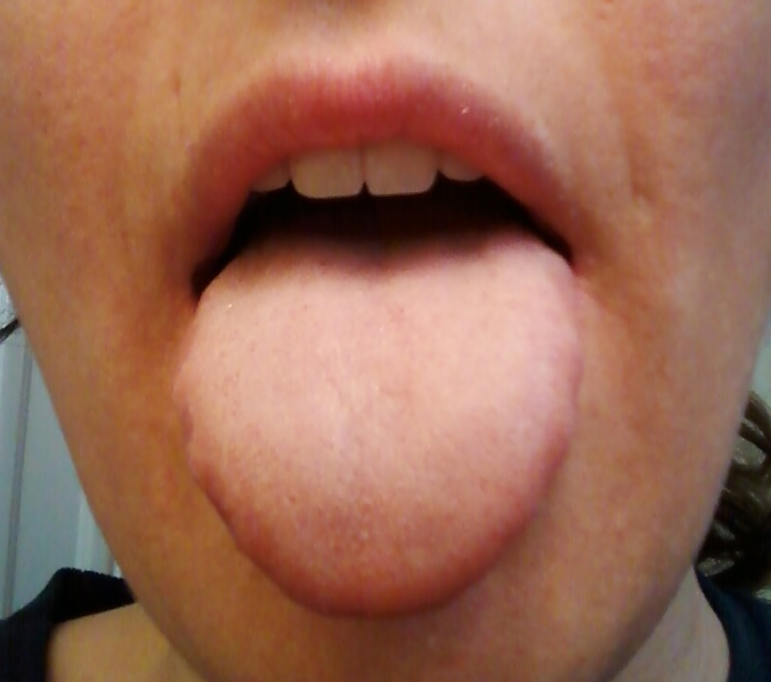
OPEN UP AND SAY AAAHHH… TONGUE DIAGNOSIS IN TCM

Slide 7
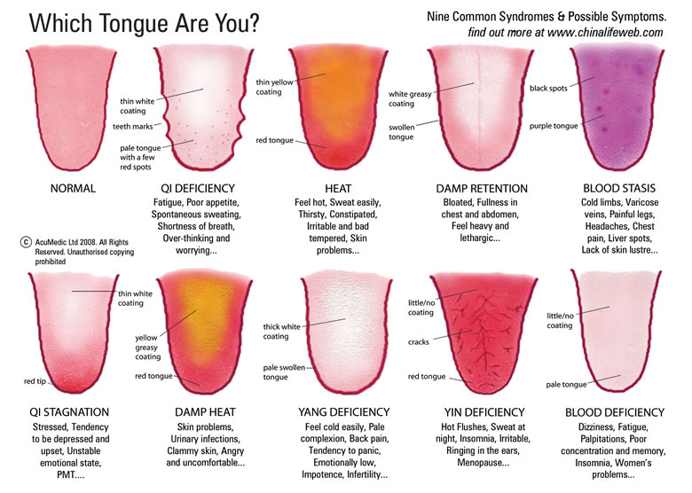
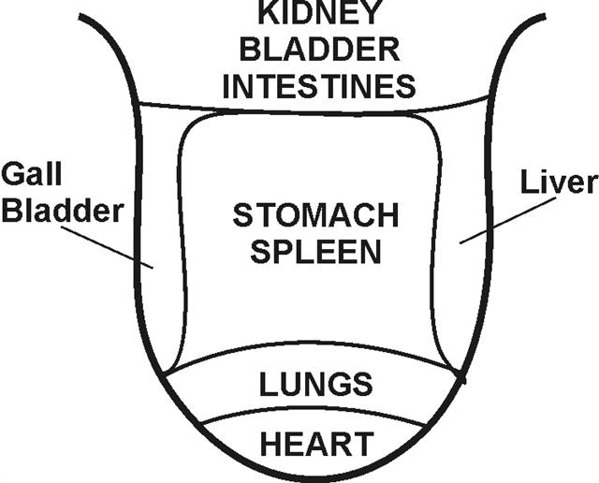
OPEN UP AND SAY AAAHHH… TONGUE DIAGNOSIS IN TCM

Slide 8
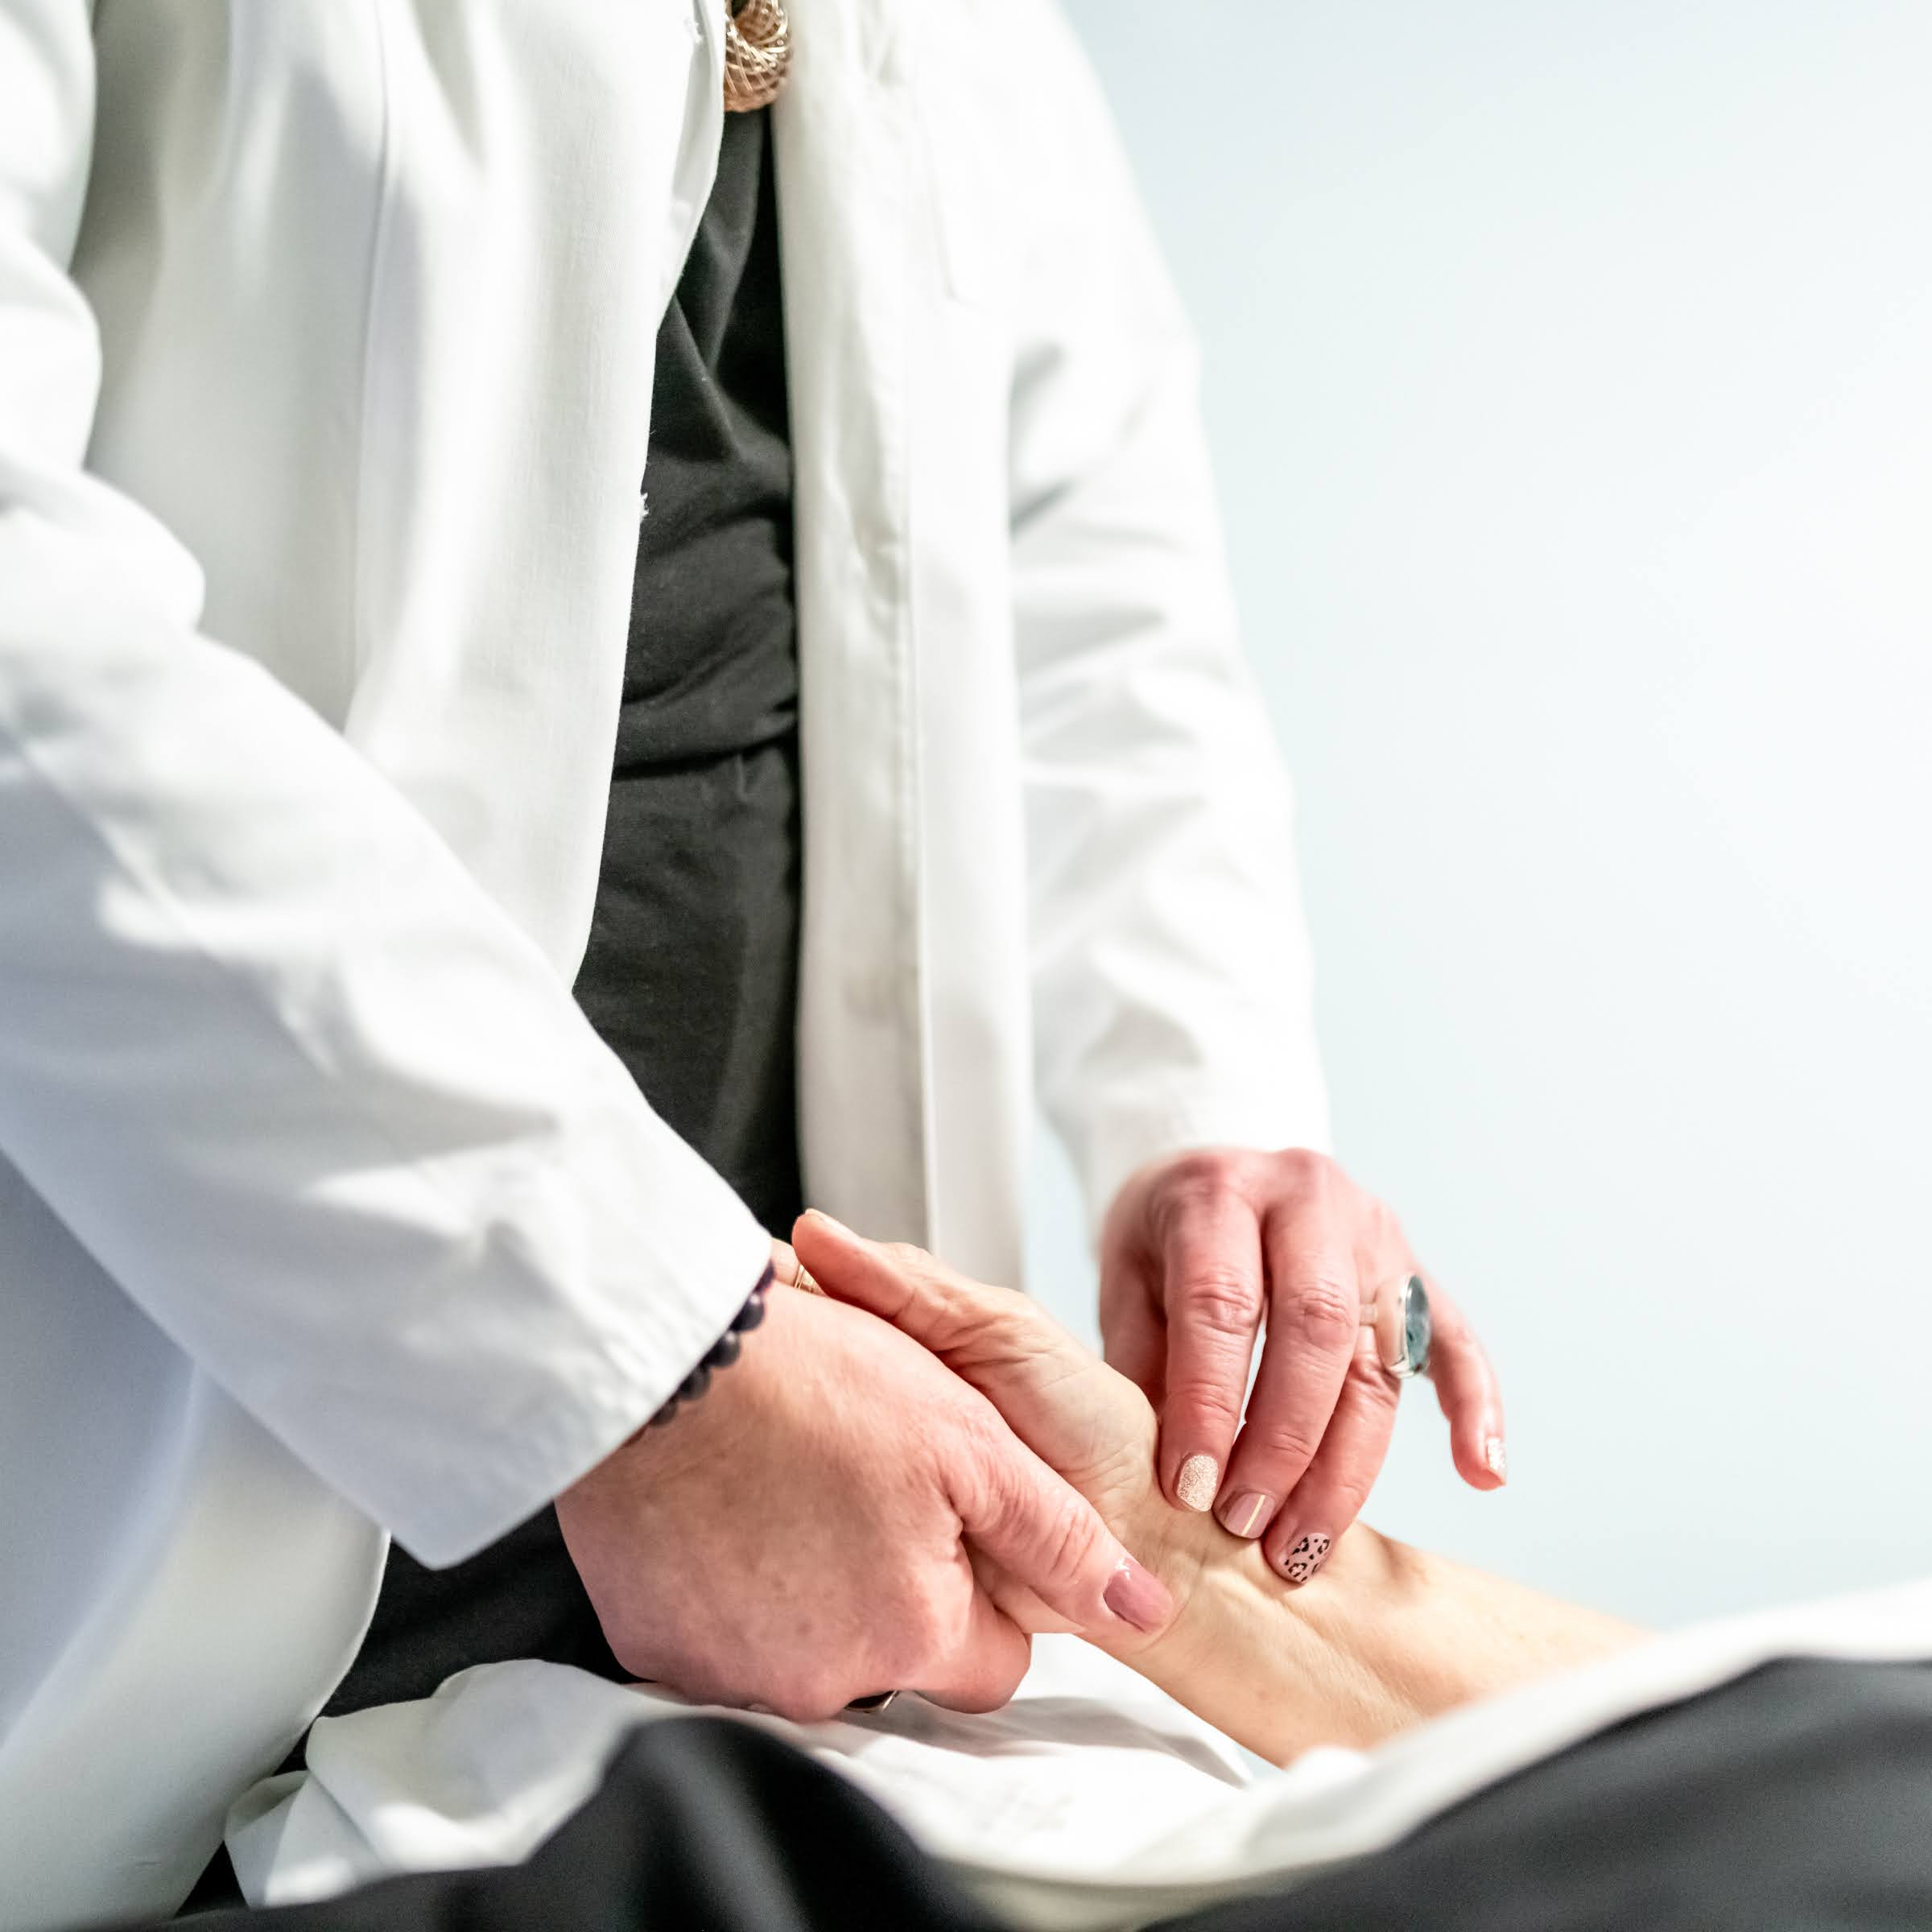
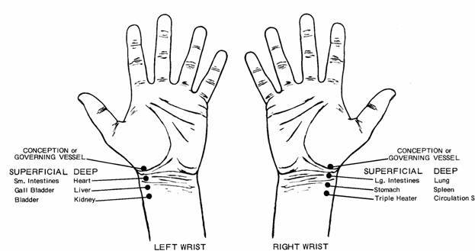
The significance of Pulse diagnosis…
The Normal Pulse: reflects good Heart Qi and Blood. It should be calm, smooth, soft, but not too soft, and not slow, rapid, rough or hard. It should be regular. Its quality should not change very often or easily. Deep level and rear position should be felt clearly, indicating that the Kidneys are healthy.

Slide 9
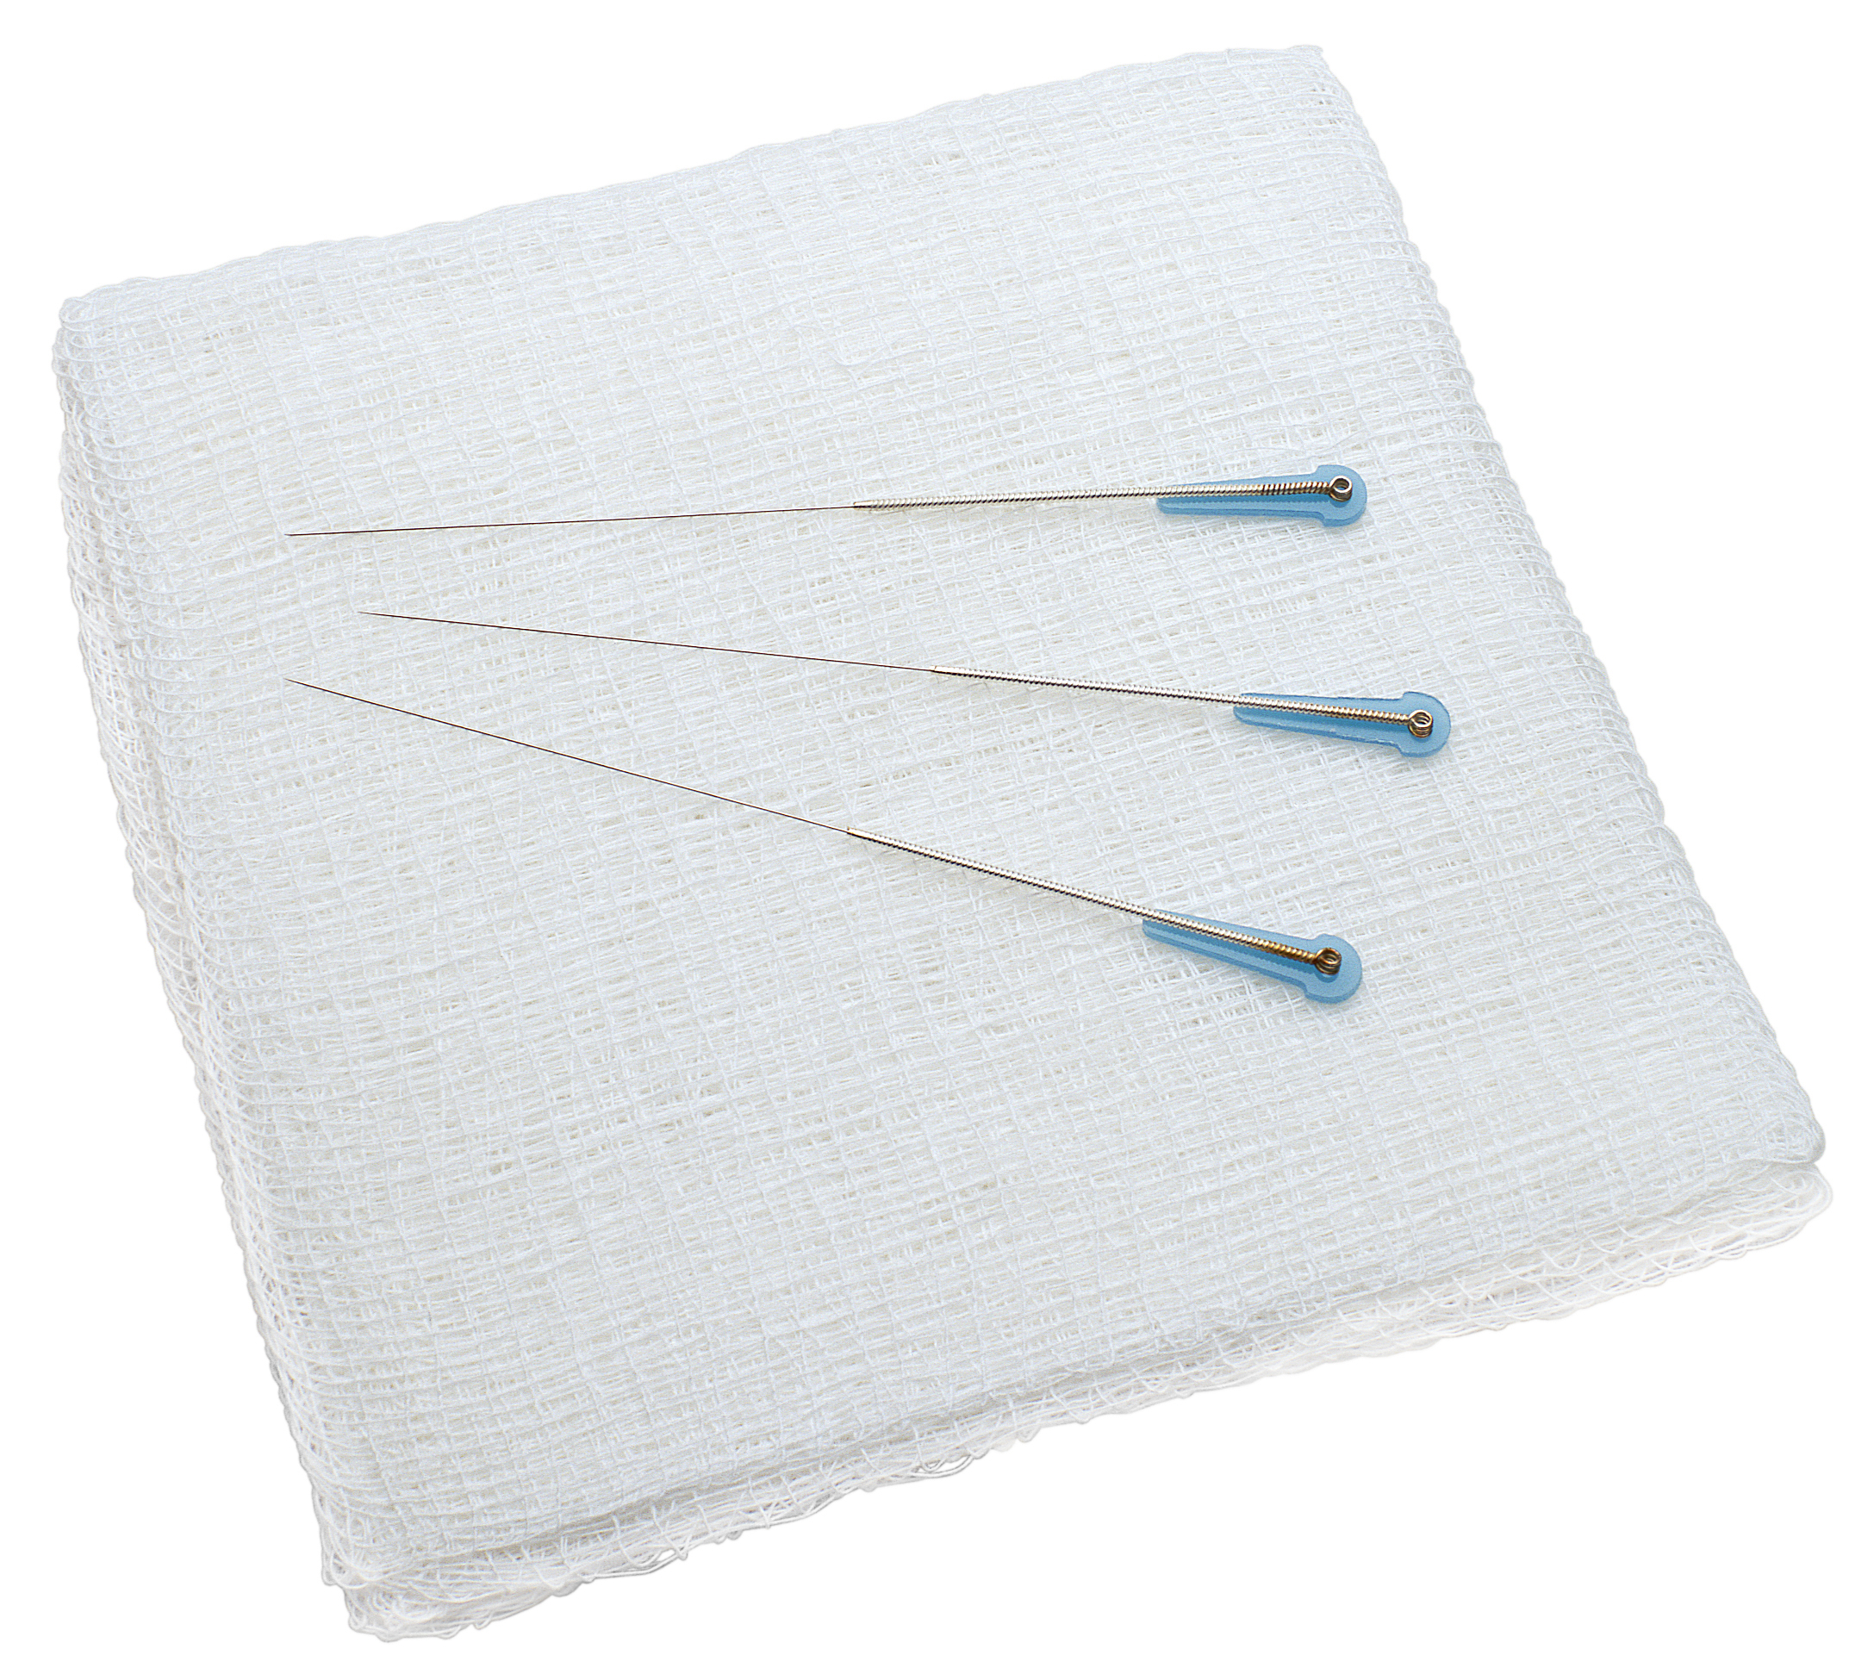
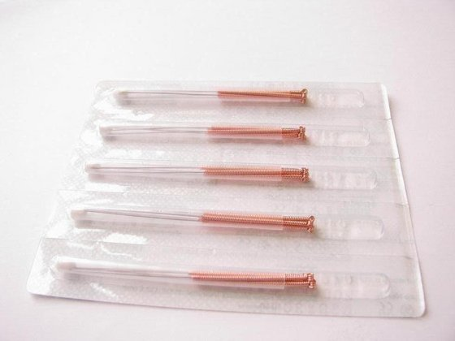
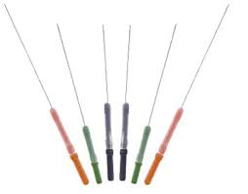
Safe & Effective
Since March 1996, the Food and Drug Administration has designated acupuncture needles with Class 2 status recognizing them as "medical tools”.
Photo Credit: [Stockbyte]/Thinkstock.

Slide 10
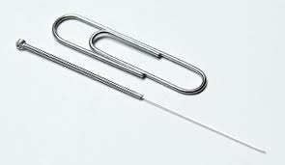
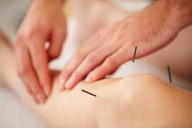
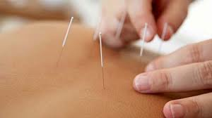
What is Acupuncture:
"Acupuncture utilizes sterile, fine filament needles that upon insertion communicate with the CNS and tells the brain to speed up the natural healing process. This is done by either releasing certain neuroreceptors or blocking them. So an immediate benefit of acupuncture is pain relief because of the release of endorphins. Locally, acupuncture can break up adhesions, alleviate trigger points, and mechanically force
contracted muscles to relax.
Because of these benefits acupuncture can treat a wide variety of issues ranging from pain and injury to addiction support, fertility, stress/trauma, and more.

Slide 11



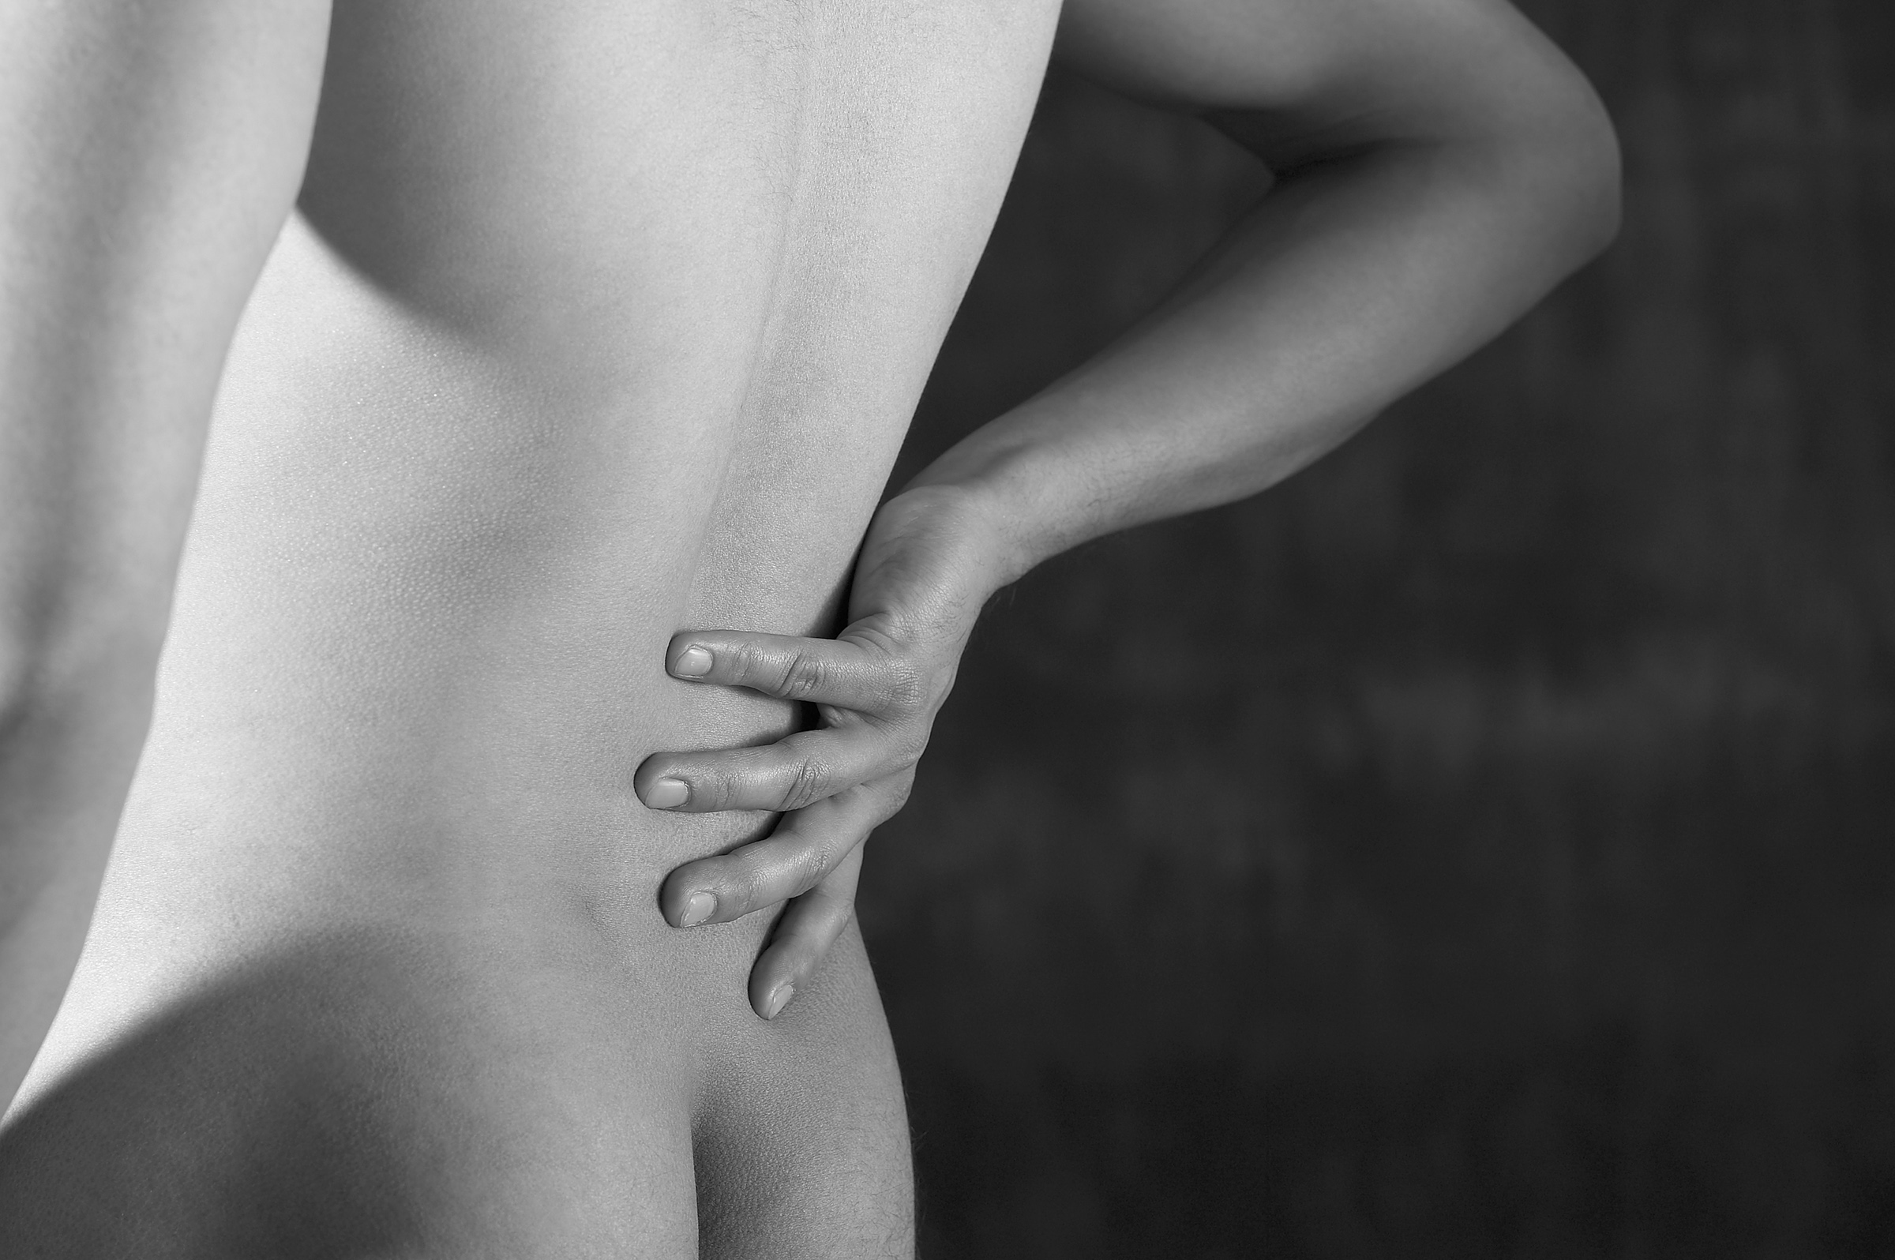
Frequently treated symptoms & clinical applications relevant to Lummi Indian Health Center
Headaches/Migraines (Extra-ordinary Meridians)
Neck, shoulder, back, hip, knee pain (Orthopedic AC)
Stress, anxiety, insomnia, trauma/PTSD (PVT)
Addiction & withdrawal support (NADA)
Women’s health & hormonal balance (Menopause and PCOS)
Digestive issues, chemo side effects (Nausea and IBS)

Slide 12
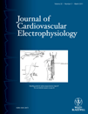
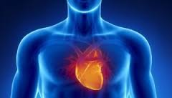
Studies suggest…
A German study found that acupuncture can create a significant reduction in both systolic and diastolic blood pressure.
At the end of six weeks and 22 acupuncture treatments, the systolic and diastolic blood pressure readings were reduced from their base-line in the patients who received acupuncture.
There was no noticeable changes with the patients who received sham acupuncture. - Circulation Journal, June 2007.
Acupuncture for paroxysmal and persistent atrial fibrillation: An effective non-pharmacological tool?
http://www.ncbi.nlm.nih.gov/pmc/articles/PMC3312232/
Efficacy of Acupuncture in Preventing
Atrial Fibrillation
Recurrences After
Electrical Cardioversion-
Dr. Fredirico Lombardi, MD.
http://onlinelibrary.wiley.com/doi/10.1111/j.1540-8167.2010.01878.x/abstract

Slide 13
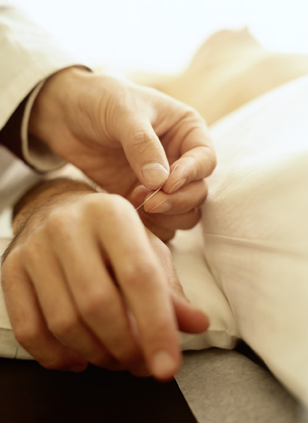
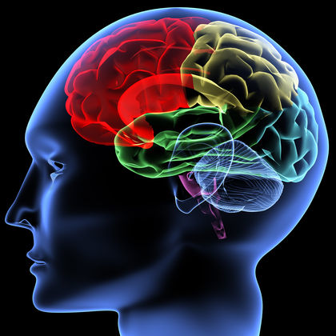
Acupuncture Theories
Gate control theory
  Acupuncture activates non-nociceptive receptors that inhibit the transmission of nociceptive signals in the dorsal horn, “gating out” painful stimuli.
  → Mayo Clinic Proceedings – Gate Control Theory of Pain in Acupuncture
Neurotransmitter theory
  Acupuncture affects higher brain areas, stimulating the secretion of beta-endorphins and enkephalins in the brain and spinal cord. The release of these specific neurotransmitters influence the immune system and the antinociceptive system.
  → Acupuncture and Endorphins (JS Han, 2004 – highly cited)
Blood chemistry theory
  Acupuncture affects the blood concentrations of triglycerides, cholesterol, and phospholipids, suggesting that acupuncture can both raise and diminish peripheral blood components, thereby regulating the body toward homeostasis.
  Acupuncture’s Neuroanatomic Basis

Slide 14
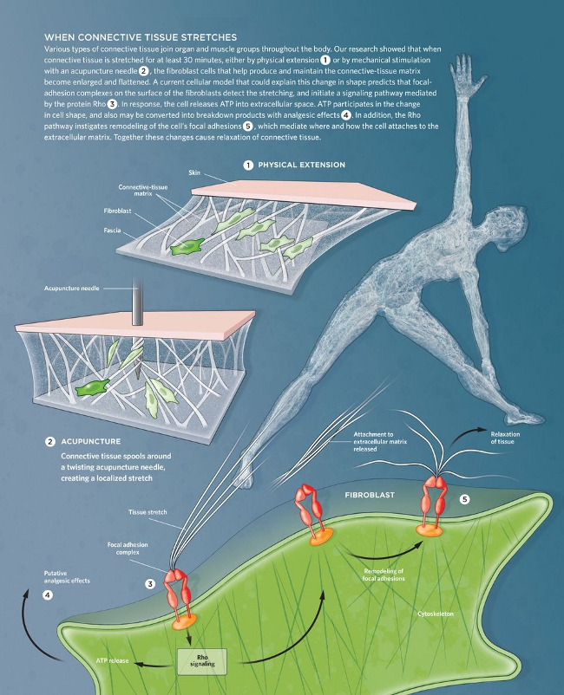
Acupuncture
Theories
Connective Tissue Theory
(Helene Langevin, MD – University of Vermont)
When an acupuncture needle is gently rotated or manipulated, it grasps and winds the surrounding loose connective tissue (fascia).
This creates a mechanical signal that:
Stretches the connective tissue matrix
Activates fibroblasts through mechanotransduction (turning mechanical force into cellular signals)
Triggers local and distant effects on pain, inflammation, and tissue remodeling
Key Finding: Acupuncture points align closely with connective tissue planes — suggesting meridians follow the body’s natural fascial network.

Slide 15
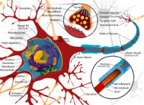
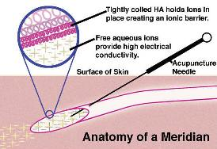
Acupuncture Theories
Autonomic nervous system theory
  Acupuncture stimulates the release of norepinephrine, acetylcholine and several types of opioids, affecting changes in their turnover rate, normalizing the autonomic nervous system, and reducing pain.
  → Acupuncture Effect and Central Autonomic Regulation (PMC Review)
  → The Autonomic Nervous System in Acupuncture (2025 Review)
Vascular-interstitial theory
  Acupuncture manipulates the electrical system of the body by creating or enhancing closed-circuit transport in tissues. This facilitates healing by allowing the transfer of material and electrical energy between normal and injured tissues.
  → Acupoint-originated Interstitial Fluid Network (PMC)

Slide 16

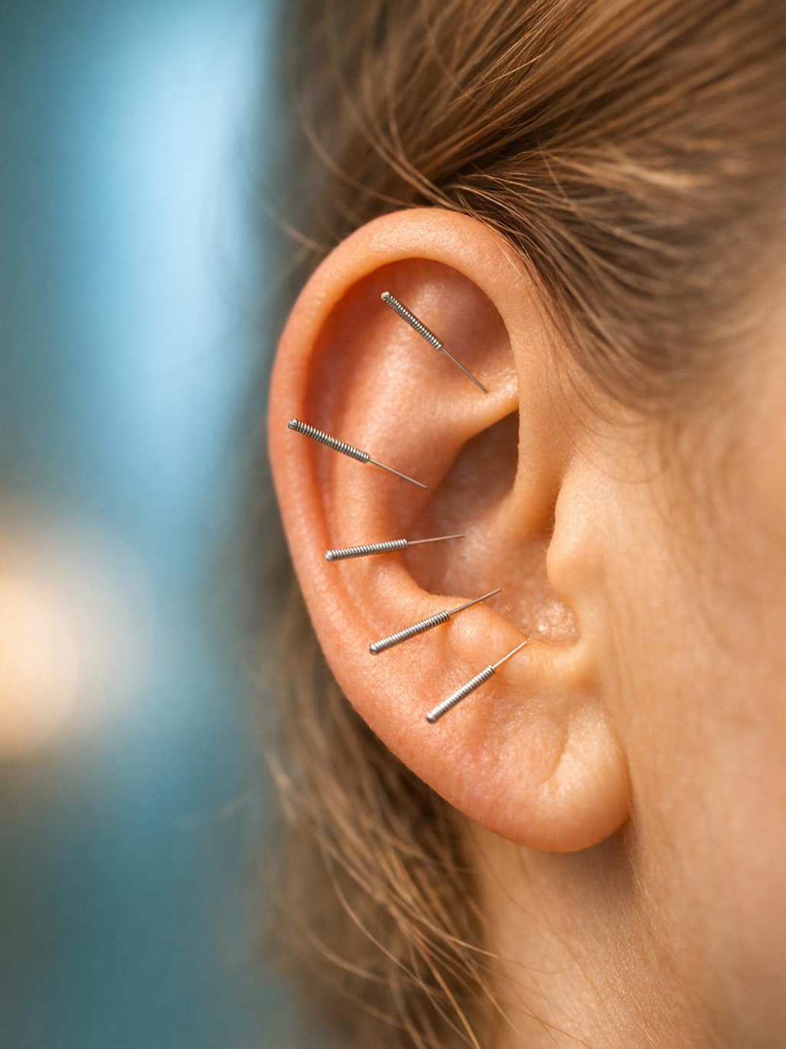
NADA Protocol for Addiction & Behavioral Health
National Acupuncture Detoxification Association (5 Ear Points)
5 Points: Sympathetic | Shen Men | Kidney | Liver | Lung
Group or individual sessions (30–45 minutes)
Reduces cravings, anxiety, and withdrawal symptoms
Improves sleep quality and treatment retention
Proven adjunct in Native communities, VA, prisons, and recovery programs
The technique is variously referred to in existing literature as acupuncture detoxification, acu detox, NADA acupuncture, the three-point protocol, the five-point protocol, five-needle protocol, 5NP, the SMART protocol, and Auricular Acupuncture (abbreviated AA).
Research: NADA Evidence Summary
NADA 5-Point Ear Protocol

Slide 17

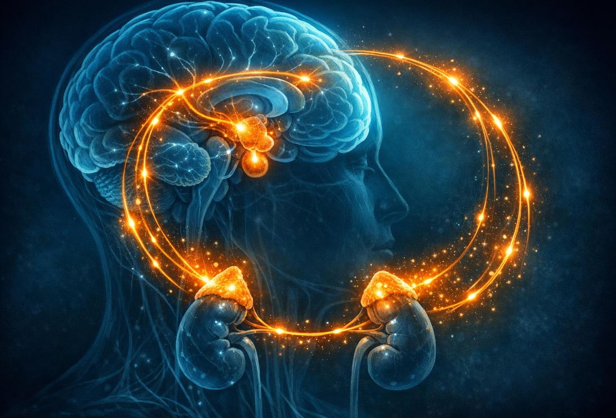
Hypothalamus / HPA Axis Regulation
Acupuncture modulates the Hypothalamus-Pituitary-Adrenal (HPA) Axis — the body’s master stress & regulatory system.
Helps balance cortisol, hormones, and the autonomic nervous system
Supports trauma recovery, anxiety, insomnia, chronic stress, and adrenal fatigue
Key Points: ST36, BL23, auricular concha, etc.
Research: Recent reviews show acupuncture regulates HPA dysfunction and improves HRV.
HPA Axis Feedback Loop

Slide 18
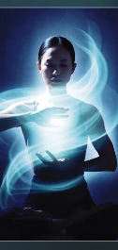
Medical Qigong
What is Qigong?
Medical Qigong is a hands-on energetic healing practice where a trained practitioner uses focused intention, breath, visualization, and sometimes gentle movements or touch to diagnose and treat imbalances in the body’s vital energy (Qi).
Watch this 2-minute summary of one of our graduating class presenting at the May 2026 Harvard Medical School conference on
"The Science of Tai Chi and Qi Gong"

Slide 19


The Science of Acupuncture — Documentary
▶ Watch
~50 min
Professor Kathy Sykes explores acupuncture’s effects with demonstrations in China, UK/US brain imaging, and real patient stories. An excellent overview of how this 2,500-year-old practice works through modern science.
Highlights:
Live acupuncture demonstrations in Chinese hospitals
fMRI brain imaging showing real-time neural responses
Patient stories bridging 2,500 years of practice with modern science

Slide 20


Collaboration with Lummi Indian Health Services
Warm referrals for pain, addiction recovery, trauma, stress, and women’s health
Group NADA sessions possible (clinic or on-site)
Culturally attuned care respecting Native traditions
Medical Qigong (in-person or distance)
Building bridges through integrative, culturally respectful healing

Slide 21
Safe & Effective:
NIH
Acupuncture performed by a licensed practitioner is one of the safest medical procedures available.
Extremely low risk of serious adverse events → Serious events occur in approximately 0.04 – 0.08 per 10,000 treatments (about 1 in 125,000+ treatments)
Most common minor effects are mild and temporary: slight bleeding/bruising at the needle site, minor soreness, or brief dizziness
FDA regulated: Acupuncture needles are Class II medical devices — sterile, single-use only
When performed by properly trained, licensed acupuncturists, complications are rare and far lower than many common pharmaceutical or procedural alternatives
Recent large reviews confirm: Acupuncture has a consistently excellent safety profile, especially when used as part of integrative care.

Slide 22
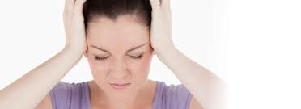
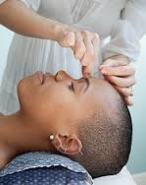
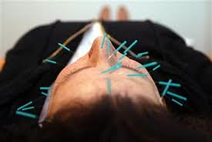
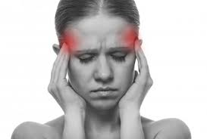
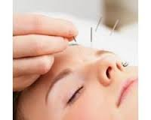
Studies suggest…
NCCIH – Acupuncture: Effectiveness and Safety (NIH)
Acupuncture: A Review of the Safety and Adverse Events (Huang et al., 2024) – New Gold Standard Review
Evidence-Based Acupuncture – Safety Overview
Cephalalgia, Vol. 28, Issue 9; 911-913

Slide 23
A Better Way Acupuncture & Medical Qigong
Dr. Shannon Freeman, D.Ac., DCEM
📍 1118 Finnegan Way, Suite 103, Bellingham, WA 98225
📞 Phone / Text (360) 366-4216
📧 Email Shannon@doctorshannonfreeman.com
[ Visit Website ] [ Book Appointment Online ] [About Shannon and her practice]

